Slide 1
HECRAS Tributary Junctions “HECRAS” - Senakadebis SekavSireba
by G. Parodi
WRS – ITC – The Netherlands
g. parodi
WRS-ITC- niderlandebi

Slide 2
Junctions- SekavSireba
Defined as two or more streams which come together or split apart.
ganisazRvreba, rogorc erTi an meti Senakadi, romlebic moedinebian erTad an iyofian.
Constructed by drawing reaches together to a common point. Draw the line representing the tributary in the direction the water will flow (the line ends at the main stream).
igeba ise, rom Senakadebi erTmaneTs uerTdebodnen erT, saerTo wertilSi. aageT Senakadis amsaxveli xazi kalapotSi wylis dinebis mimarTulebiT (Senakadis amsaxveli xazi mTavrdeba ZiriTad mdinaresTan).
For splitting flow, draw lines in the direction water will flow.
dinebis danawevrebis mizniT ixazeba xazi wylis dinebis mimarTulebiT.
Can be modeled using the energy equation or momentum equation.
SesaZlebelia modlireba energiis gantolebis an momentis gantolebis gamoyenebiT.

Slide 3
Junctions - 6 Types SekavSireba – 6 tipi
Subcritical flow - flow combining
subkritikuli dineba – dinebis kombinireba
Subcritical flow - flow splitting
subkritikuli dineba –dinebis danawevreba
Supercritical flow - flow combining
superkritikuli dineba – dinebis kombinireba
Supercritical flow - flow splitting
superkritikuli dineba - dinebis danawevreba
Mixed flow - flow combining
Sereuli dineba – dinebis kombinireba
Mixed flow - flow splitting
Sereuli dineba – dinebis danawevreba

Slide 4
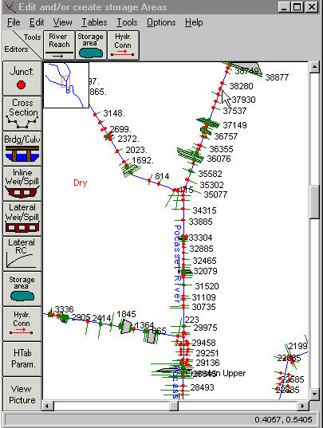
Junctions - SekavSireba
Press the River Reach button and cursor turns to a pen.
daawkapuneT Rilaks dasaxelebiT “River Reach” (“mdinaris gawvdoma”) da kursori gadaiqceva kalmad.
Hold down the left mouse button and draw in the direction of flow.
SeakaveT mausis marcxena Rilaki miWeril mdgomareobaSi da mihyeviT mdinaris dinebis mimarTulebas.
Release and press left mouse button to change line direction (gives shape to the schematic).
auSviT da isev daaWireT TiTi mausis marcxena Rilaks raTa SecvaloT xazis mimarTuleba (vRebulobT sqematur naxazs).
At the end of the reach double click the left mouse button. This will terminate the reach drawing.
obieqtis gamosaxvis dasamTavreblad daawkapuneT mausis marcxena Rilaks orjer.

Slide 5
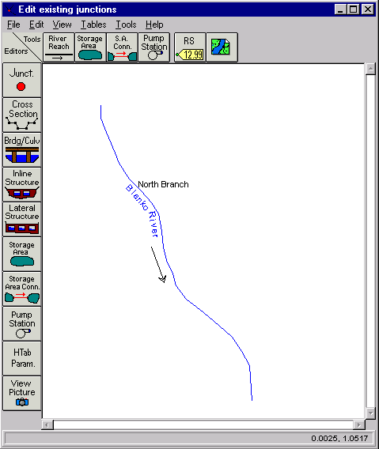
Construction of a junction SekavSirebis ageba
Draw first the main river Reach
dasawyisisTvis daxazeT ZiriTadi mdinaris gavrceleba, gawvdoma.
Draw the tributary to the proximity of the future junction. Double click to the end.
daxazeT Senakadi momavali…gadambims wertilamde, orjer daawkapuneT procesis bolos.
This triggers a sequence of data requirements (1 thru 4) for entering a tributary and junction
es iwvevs Sesayvani monacemebis Tanmimdevrobas (1- dan 4-mde) imisTvis, rom mivuTiToT Senakadebis da SekavSirebis monacemebi.

Slide 6
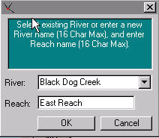
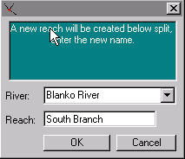
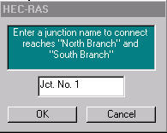
1.
The tributary request a name
Senakadi moiTxovs saxels
A splitting of the main
river is requested.
ZiriTadi mdinaris danawevreba
aucilebelia
2.
Select “Yes”.
airCieT “ki”
A name for the split river and the junction are requested
dasaxelebis miwodeba danawevrebuli mdinarisTvis da gadabmis wertilisTvis savaldebuloa
3.
4.

Slide 7
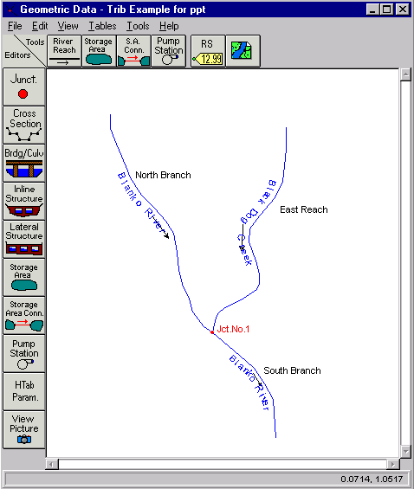
Construction of a junction SekavSirebis ageba
Schematic of Blanko River with the Black Dog Creek tributary.
md.blankos da bleq dog griiqis Senakadis sqematuri naxazi.
Blanko River is split between the North Branch and South Branch at jnction No. 1
md.blanko gayofilia or, Crdilo da samxreT Stod, #1 kveTis wertilis meSveobiT.

Slide 8
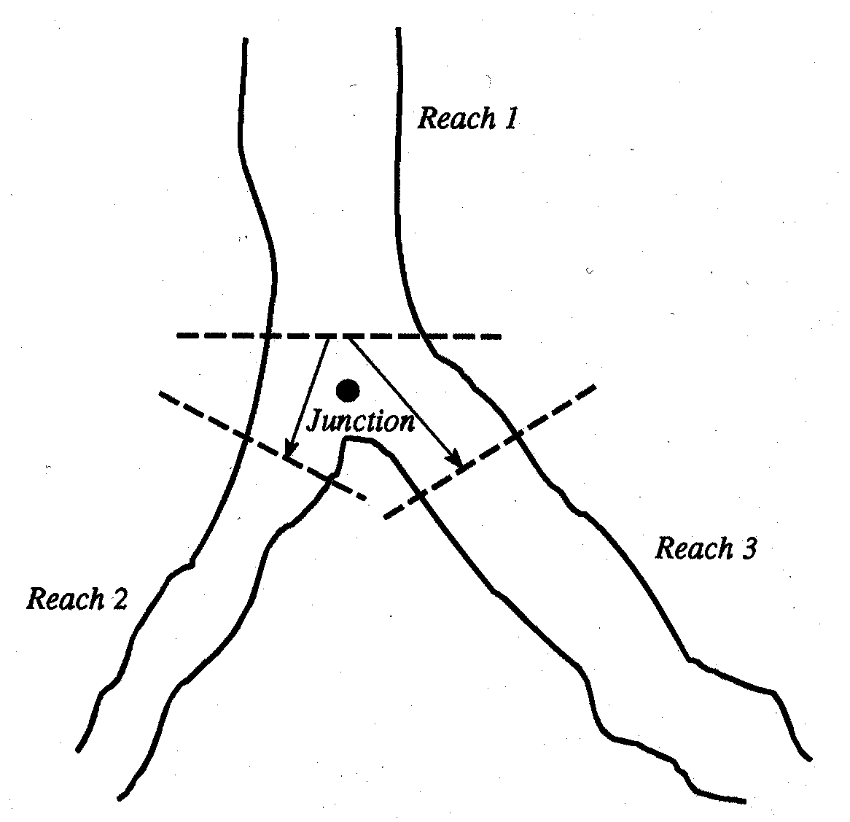
Junctions SekavSireba
Each of these reach lengths are entered in the Junction Data window.
yoveli mocemuli segmentis gawvdomis sigrZe registrirebulia SekavSirebis wertilis monacemTa fanjaraSi.
The downstream reach length shown on the upstream cross-section data window should be set to zero.
qveda dinebis gawvdomis sigrZe, romelic naCvenebia zeda dinebis ganivi kveTis monacemTa fanjaraSi unda daviyvanoT nulamde.

Slide 9
Junctions - Reach Lengths SekavSireba – gavrcelebis sigrZe
For cross sections upstream of the junction, the reach length should be zero (in the cross section interface).
zeda dinebis ganivi kveTisTvis (SekavSirebis wertilTan mimarTebaSi), monakveTis sigrZe unda iyos nuli (ganivi kveTis sazRvarze).
Cross sections should be as close to the junction as possible.
ganiv kveTi unda iyo SeZlebisdagvarad maqsimalurad axlos SemakavSirebel wertilTan.
Go into the Geometric Cross Section editor to change these lengths.
SevideT ganivi kveTis geometriuli redaqcirebis ganyofilebaSi obieqtebis sigrZis Sesacvlelad.
Distance across the junction is generally, the average distance that water will travel between cross sections across a junction.
manZili SekavSirebis wertilis gaswvriv rogorc wesi aris saSualo manZili, romelsac wyali gaivlis ganiv kveTebs Soris moZraobisas, gadakveTis wertilis gaswvriv.

Slide 10
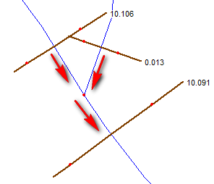
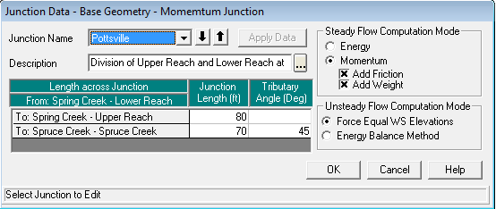
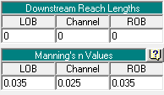
How it should look like? rogor unda gamoiyurebodes sqematuri anxazi?
None of the sections cut each other or overlap!!
arcerTi segmenti ar unda kveTdes an emTxveodes erTmaneTs.
Upstream sections (0.106 and 0.013) should have downstream reach lengths equal zero in the cross section editor.
zeda dinebis seqciebs (0.106 da 0.013) unda hqondeT qveda dinebis gawvdomis sigrZe nulis toli, ganivi kveTis seqciis editorSi.
The lengths should be stated in the junction Data that appears pressing
sigrZe unda ganisazRvros SekavSirebis monacemebSi romelic gamoCndeba Rilakze daWeris Semdeg.

Slide 11
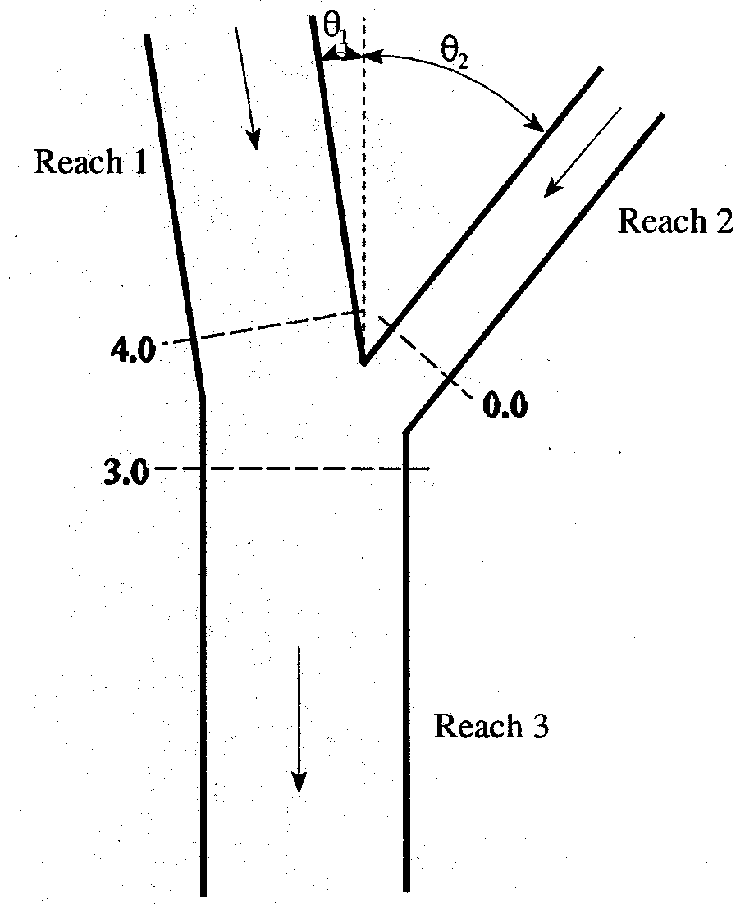
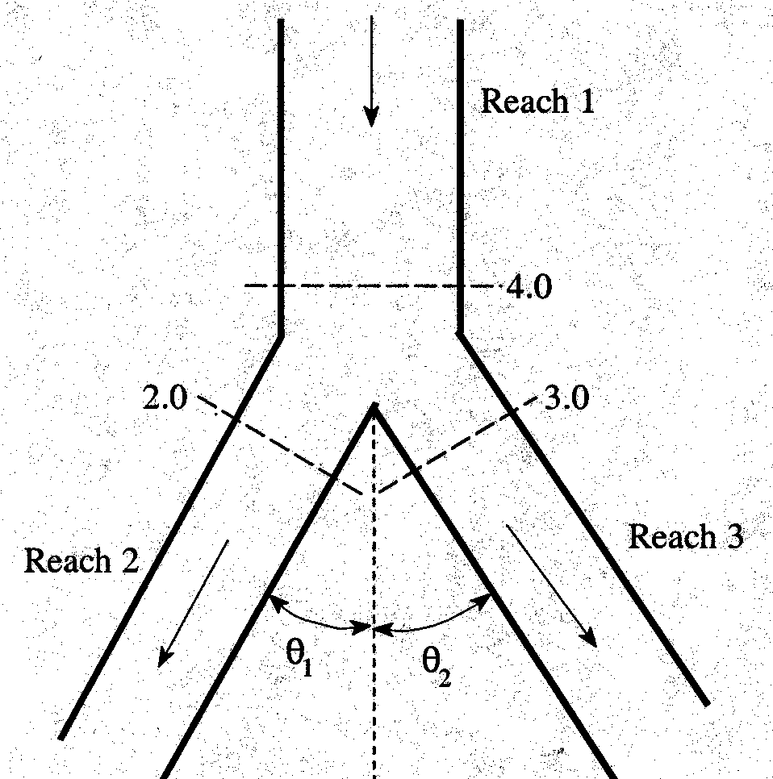
Junctions - Energy vs Momentum SekavSireba – energia Tu momenti
Where angle of tributary can cause significant energy losses, it is more appropriate to use the momentum equation.
im SemTxvevebSi, rodesac Senakadebis SeerTebis kuTxe ganapirobebs energiis did danakargs, mizanSewonilia gamoviyenoT momentis gantoleba.
No angle is entered for the reach that is part of the mainstream if there is no angle between the mainstream reaches u.s. and d.s. of the tributary.
kuTxes ar vuTiTebT gawvdomisTvis, romelic aris ZiriTadi mdinaris nawili, Tu ar gvaqvs mocemuli kuTxe ZiriTadi mdinaris zeda da qveda dinebas Soris.

Slide 12
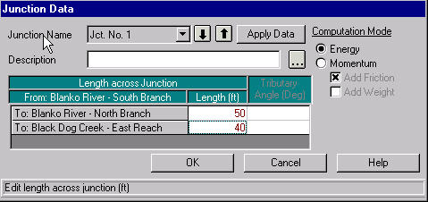
Junctions - SekavSireba
or, point the mouse at the junction, left click and select “Edit Junction”.
an, miuTiTeT mausiT Rilaki “JUNCT”, SekavSireba, mausis marcxena Rilakze daWeriT airCieT redaqtirebis funqcia “Edit Junction’’.

Slide 13
Junctions - Split Flows SekavSireba – danawevrebuli dineba
For split flows, i.e. when the stream is divided or split apart in the downstream direction, the program can optimize the amount of flow going in each direction.
gayofili nakadebisTvis, magaliTad rodesac nakadi iyofa qveda dinebis mimarTulebiT, programas SeuZlia wylis raodenobis optimizacia orive mimarTulebiT.
The user must estimate the initial flows going in each direction. It only is available for steady flow analysis.
momxmarebelma unda gansazRvros sawyisi raodenoba yoveli mimarTulebisTvis. es SesaZlebelia mxolod ucvleli dinebis analizis dros.

Slide 14
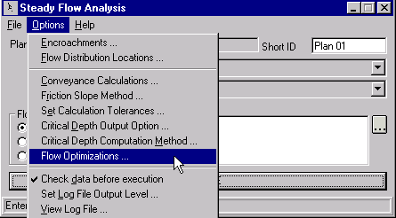
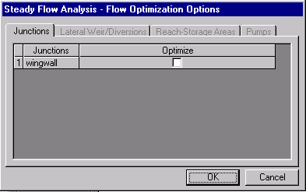
Junctions - Split Flows SekavSireba – danawevrebuli dineba
The optimization is found under the steady flow analysis window .
optimizacis funqcia SegviZlia vixiloT Tanabari dinebis fanjris CamoSlisas.

Slide 15
Junctions - Cross Section Locations SekavSireba – ganivi kveTebis mdebareoba
3 Criteria for XS’s near junctions:
3 kriteriumi XS-is mimdebare SekavSirebisTvis:
Locate them close to junction. Another cross section may be transferred if representative.
ganaTavseT isini SekavSirebis wertilTan axlos. sxva ganivi kveTa SeiZleba gadavaadgiloT Tu is aris tipobrivi, damaxasiaTebeli.
Cross-Sections should not overlap (the ends may touch upstream of junction for example).
ganivi kveTebi ar unda emTxveodnen erTmaneTs (ganivi kveTis boloebi, SeiZleba exebodnen zeda dinebas magaliTisTvis).
Should be located where flow is essentially one-dimensional.
unda mdebareobdnen iq, sadac dineba arsebiTad erTi mimarTulebiT xasiaTdeba.

Slide 16
End of lecture
leqciis dasasruli

