Slide 1
Introduction to webservices
Ulanbek turdukulov
ITC

Slide 2
http and CGI
http://www.example.com/path/file.html
Translated into: GET /path/file.html HTTP/1.1
Host: www.example.com
CGI a standard protocol for interfacing external application software with a web server (Wikipedia)

Slide 3
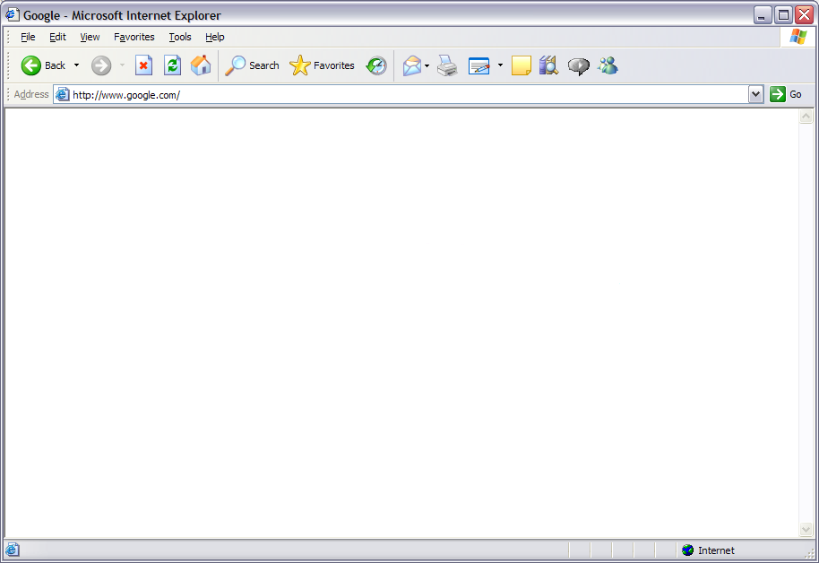

Web Service Operation
Client
Web Server
(Listening for requests)
1. Creates Request
Convert UTM To Lat/Long
2. Request sent to web service
Zone: 18
Easting: 623,456.3
Northing: 4,745,342.3
Longitude: -73.3456
Latitude: 42.2753
Processing….
3. Receives request
7. Receives response and parses
6. Response sent to client
4. Calls the function
5. Creates response with results

Slide 4

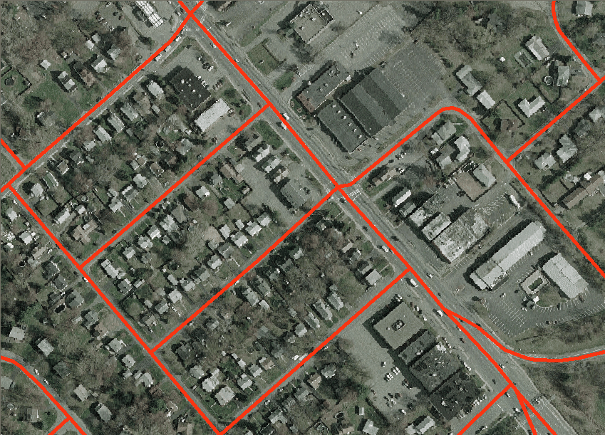
Map Service Operation
Client
Web Server/Map Server
1. Creates Request
2. Request sent to web service
8. Receives response, parses to extract image and updates map
3. Receives request
7. Response sent to client
4. Calls the map server to request map
5. Map Server generates map as image file
6. Creates response with image file

